Slide 1
Southern Virginia GO Region 3
Advisory Committee
Spring Update 2018
March 1, 2018 & March 5, 2018

Slide 2
Topics for Review
GO Virginia Overview
Organizational Updates
Growth & Diversification Plan Areas of Critical Need
Results of Round 1 Project Solicitation
Round 2 Project Solicitation Timeline
How can you Help?

Slide 3
GO VIRGINIA
Business-led bipartisan initiative providing framework for strengthening economy in Virginia’s regions
Represents a new approach to economic development in Virginia
Incentivizes collaboration for initiatives that create high-paying jobs
Preserves local autonomy; uses incentives, not mandates
http://www.dhcd.virginia.gov/index.php/go-virginia.html

Slide 4
GO VIRGINIA
Purpose Statement
To create more high paying jobs through incentivized collaboration, primarily through out-of-state revenue, which diversifies and strengthens regional economies.

Slide 5
GO VIRGINIA OVERVIEW
State Board provides policy & program direction & guidance
Majority business leaders
Staffed by Virginia Department of Housing & Community Development
Requires regional thinking on prioritizing economic growth strategies
Project collaboration must include at least 2 localities; may include more, or inter-regional, or interstate

Slide 6
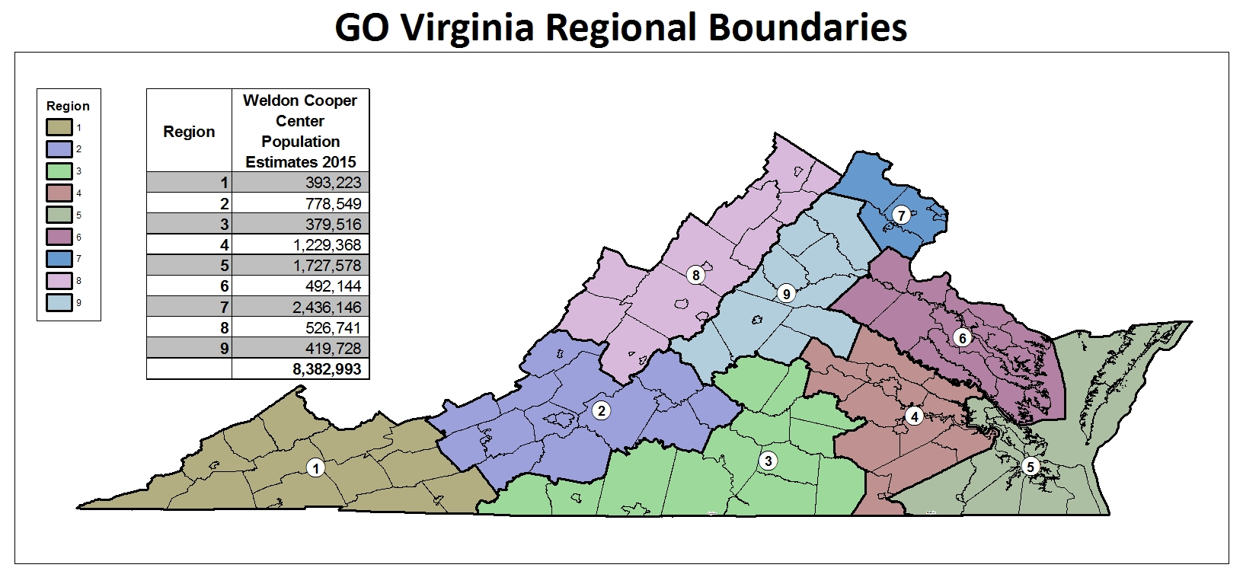

Slide 7
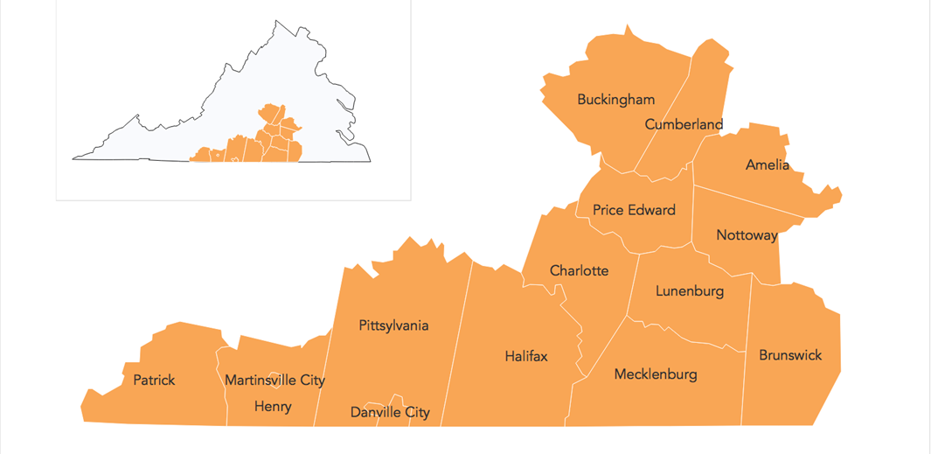
SOUTHERN VIRGINIA GO REGION 3

Slide 8
GO Virginia State Board
Working Group
Executive Committee
Region 1
Region 2
REGION 3
COUNCIL
Region 4
Region 5
Region 6
Region 7
Region 8
Region 9
G&D Committee
Executive Committee
Comm’tions Strategy Committee
Small Business
Innovation Assets
Local Gov. & PDCs
Education & Workforce
Large Business Employers
Economic Developers
Ag & Natural Resources
Legislative & State Boards
Community & Civic Leaders and NPs
Young Leaders

Slide 9
Region 3 Overview

Slide 10
SOUTHERN VIRGINIA GO REGION 3 COUNCIL MEMBERS
  Adam Birkett, Business/Manufacturing, Patrick
  Scott Burnette, Business/Health, Mecklenburg
  Timothy Clark, Business/Construction, Pittsylvania
  Barbara Johnson, Education, Prince Edward
  Randolph Lail, Business/Retail, Lunenburg
  Charles Majors, Business/Financial Services, Danville
  James McClain, Business/Energy, Martinsville
  Ronald Roark, Public/Locality, Nottoway
  Al Roberts, Public/Workforce, Brunswick
  Larry Ryder, Business/Manufacturing, Henry

Slide 11
SOUTHERN VIRGINIA GO REGION 3 COUNCIL MEMBERS (cont.)
  Roger Scott, Business/Tool Distribution, Amelia
  Karl Stauber, Non-Profit, Danville
  Sherry Swinson, Higher Education, Prince Edward
  Bob Timmons, Public/Locality, Prince Edward
  Denise Taylor-Forrest, Business/Manufacturing, Halifax
  Telly Tucker, Economic Development, Danville
  Lauren Willis, Business/Finance, Charlotte
  Dennis Witt, Civic, Halifax
  Nicole Young, Business/Financial Services, Brunswick

Slide 12
Region 3 Advisory Committee Chairmen
  Education & Workforce: Dr. Barbara Johnson, Dennis Witt
  Economic Development Professionals: Telly Tucker, Bob Timmons
  Local Government & Planning Districts: Ronnie Roark
  Legislative, State Boards & Commissions: Tim Clark
  Community Leaders: Scott Burnette
  Large Business Employers: Denise Taylor-Forrest, Larry Ryder
  Young Leaders: James McClain, Nicole Young
  Council Committee Liaisons:
    Al Roberts: Education & Workforce; Legislative, State Boards & Commissions; Large Business Employers
    Sherry Swinson: Local Government, Community Leaders, Young Leaders, Economic Development Professionals

Slide 13
Region 3 Advisory Committee Roles
Provide direct input into the Economic Growth and Diversification Plan development (completed)
Assist in identifying projects for the Southern Virginia Regional Council to consider for investment of funds (ongoing)
Be available to serve as members of the Project Review Panel (2 committees represented in Round 1)
Assist the Support Organization in assessing the impact of projects (2 committees represented in Round 1)
Serve as a communication channel to/from stakeholders in all parts of the Southern Virginia Region (ongoing)

Slide 14
Organizational Actions

Slide 15
Region 3 Actions
Three Requests for Proposals currently underway
  Communications, Branding & Marketing Strategy (In negotiations)
  Areas of Critical Need Assessments
      High-Value Wood Products (GENEDGE, complete by July, 2018)
      Apprenticeships (Institute for Advanced Learning & Research; complete by July, 2018)
      Cyber Infrastructure (on hold until clarification from State Board)

Slide 16
2018 Calendar Primary Dates
DATE | EVENT
March 1 | Round 2 Project Solicitation Opens
March 7 | Round 2 Instructional Webinar
March 28 | Council meeting including GO-TEC presentation (invited)
April 2 | Round 2 Project Applications Due
April 10 | State Board (Competitive and Per Capita)
April 18 | Executive Committee (Applicant Presentations OPEN session)
May 16 | Council Annual Meeting and Project Reviews
June 12 | State Board (Per Capita)
June 21 | Region 3 All Hands Meeting

Slide 17
2018 Calendar Primary Dates (continued)
DATE | EVENT
June 27 | Executive Committee
July 25 | Council Meeting
August 14 | State Board (Competitive and Per Capita)
September TBD | Advisory Committee Meetings
September 26 | Council Meeting
October 9 | State Board (Per Capita)
October 17 | Executive Committee
November 14 | Council Meeting
December 11 | State Board (Competitive and Per Capita)
December 19 | Executive Committee

Slide 18
Region 3
Growth & Diversification Plan
Areas of Critical Need

Slide 19
Region 3 Growth & Diversification Plan Summary
Greatest Opportunity:
Align Workforce/Talent with Economic Development
Greatest Gap:
Aging & Shrinking Population

Slide 20
Growth & Diversification Plan Summary
Areas of Critical Opportunity
  Workforce Talent & Recruitment
  Sectoral Development
  Cyber Infrastructure
Notes:
Workforce Talent Development and Recruitment — Making sure we develop and retain people that have the hard and soft skills our region needs to advance economic opportunity and the growth of higher wages;
Sectoral Development — Given limited resources, what are the business sectors that have the greatest potential of growing the number of employees, the wage levels and the types of businesses in the region; and
Cyber Infrastructure — In the 19th Century it was railroads, in the 20th Century it was roads; going forward it will be areas with internet and broadband that will be more competitive; all of this region must be "connected" with this infrastructure in order to sustain a healthy economy.

Slide 21
Growth & Diversification Plan Summary
Workforce Talent & Recruitment
  Sector Partnerships
  Work-Based Learning Experience
  Talent Recruitment
  Most Prominent Gig-Speed Region
Notes:
Sector Partnerships: These create Career Pathways, particularly employer and educator leadership, to design career pathways in each sector. The goals of the career pathways are to more effectively guide our budding talent to in-demand, high-wage career opportunities, and to attract private sector investment and economic development opportunities. Example: Capstone Integrated Machining Technology Program (a partnership between Danville Community College and the Institute for Advanced Learning & Research.
Work-based Learning: Provide a work-based learning (WBL) experience to 100% of public high school students, with introductory experiences that begin in elementary school. This will help to ensure that our students are aware of and prepared for the in-demand career opportunities available to them in Region 3 and enable private-sector businesses to identify potential employees earlier in their career development.
Recruitment: Work with local government, economic developers, and other key stakeholders to create innovative incentives to recruit talent, entrepreneurs, and small business owners in the prioritized sectors.
Gig-Speed: Broadband: Utilize the competitive advantage that Mid-Atlantic Broadband provides to first, attract and grow businesses and industries of all sizes that rely upon this highspeed network access and second, support workforce talent recruitment and retention.

Slide 22
Growth & Diversification Plan Summary
Sectoral Development
  Business Services/IT Data Centers
  Advanced Manufacturing & Materials
    Aerospace
    Production Technology
    Lighting & Electrical Equipment
    Automotive/OTR Trucks
    Biopharmaceuticals
  High Value Natural Resource Products
  Health Care*
Notes:
Only one out of every four employees in the region (25%) is currently employed in a position that creates or attracts wealth for the region. According to US Cluster Mapping, the national average for this metric is 36%, providing a benchmark to which the region can aspire. In this section of the report, four target sectors are identified as key sectors that Region 3 should be pursuing. These target sectors were selected because they represent the best opportunities for the region to increase its share of higher paying, in-demand occupations, leading to a corresponding increase in per capita income.

Slide 23
Growth & Diversification Plan Summary
  Cyber Infrastructure
Regional Solutions for Broadband
Improve Business Climate for Broadband Coverage By Focusing On Business Climate Issues that Attract:
  Middle-Mile Technology Companies
  Last-Mile Technology Companies
Notes:
.
In the 19th Century it was railroad infrastructure that rendered a region competitive; in the 20th Century it was roads. Today, the development of cyber infrastructure and broadband access is critical to ensure that the region is “connected,” competitive, and able to sustain a healthy economy.
A regional approach to cyber infrastructure (in lieu of a piecemeal approach by localities) will enable pooling of intellectual and financial resources and more efficient development of networks.
The region seeks to develop a project that improves broadband coverage by facilitating the action of “middle-mile” and “last mile” technology companies by creating region-wide tax-exempt statuses, fee waivers, and expedited easement access for such providers.

Slide 24
Results of Round 1
Project Solicitation Process

Slide 25
Summary of Project Applications
5 Applications Received
3 in Talent Development
1 in Cyber Deployment
1 in Infrastructure Development
Geographic Distribution
All 5 applications from western sub-region

Slide 26
Summary of Round 1 Project Solicitation
Total Funding Requested
$1.465 million
Total Funding Available
$720,000
Total Funding Approved
$648,000

Slide 27
Summary of Project Applications
Total Match Funding Leveraged
$10.9 million
# Local Partners Engaged/Application
Project A: 3 localities
Project B: 3 localities
Project C: 15 localities
Project D: 2 localities
Project E: 4 localities

Slide 28
ROUND 1 PROJECT REVIEW TEAM
  Karl Stauber, Region 3 Council Member (Co-Chair)
  Lauren Willis, Region 3 Council Member (Co-Chair)
  Jordan Miles, Piedmont Senior Resources (Young Leader Advisory Committee Representative)
  John Parkinson, CEO Drake Extrusion (Large Business Employer Advisory Committee Representative)
  SUBJECT MATTER EXPERTS
  Jeff Brown, Director of Workforce Development, Governor’s Office (Workforce)
  Shervin Gerami, CEO, Teleworld Solutions (IT/Broadband)
  Glen “Skip” Skinner, Blue Ridge Advisory Services Group (Sites & Infrastructure)

Slide 29
Project Approved
GO-TEC
Expands existing curriculum offered by 6 higher education partners
Builds regional training system of scale in IT and Advanced Manufacturing from middle school thru Capstone level
Incorporates entire footprint of Region 3
Substantial match commitments

Slide 30
Lessons Learned from Round 1
Earlier promotion of solicitation for applications
Timing: be aware of impact of holidays on timetable
Simplify and align project application template
Clarify definitions (i.e. “locality”)
Provide more real-time coaching to applicants as project applications are developed
Incorporate an opportunity for applicants to present to Council or Executive Committee early in process, to set context of reason for application
Identify Subject Matter Experts earlier in timeline
Maintain solicitation process in closed sessions

Slide 31
Round 2
Project Solicitation Timeline
Tim

Slide 32
Region 3 Round 2 Funds Available
Round 2 Total Funding
Dependent upon Results Of 2018 State Budget Actions

Slide 33
Project General Criteria
Align with Areas of Critical Opportunity
Demonstrate Regional Collaboration and Impact
Result in Higher-Paying Jobs
Types of Applications
Requests for Ideas (welcomed any time)
Enhanced Capacity-Building (approval at Council level)
Per Capita Projects
State Competitive Projects

Slide 34
TIMELINE OF STEPS
  March 1 – Round 2 Project Solicitation Announced
  March 7 – “How To Apply” Webinar, 9AM (posted on SPDC Website)
  March 7 – April 2 – Applicant discussions with Region 3 staff
  April 2 – Round 2 Project Applications Due
  April 3 – April 11 – Staff Review for Qualifying Criteria
  April 11 – 25 - Review Team/Subject Matter Experts’ Individual Review of Round 2 Applications
  April 18 – Executive Committee Meeting; Applicant Overview Presentations (OPEN SESSION/new step)
  April 25 - Review Team Meeting for Round 2 (evaluation and scoring)
  May 16 – Region 3 Council review and approve Round 2 Applications for recommendation to State Board and/or Council Approval of Enhanced Capacity Grants under $100K
  July 13 – Round 2 Applications Submitted to DHCD
  June 27 – Executive Committee meeting
  August 14 – State Board Approves Round 2 Applications

Slide 35
ROUND 2 PROJECT EVALUATION STEPS
  March - April:
    Applications prepared
    Questions received and responded to by Contract Staff
  April 18 – Applicant Overviews to Executive Committee (OPEN SESSION)
  April 25 – Region 3 Review Team Meeting
    Using standard score sheet
      Economic Impact – 35%
      Regional Collaboration – 30%
      Project Readiness – 20%
      Project Sustainability – 15%
    Includes Subject Matter Experts (SME)
    Applicant Deep Interviews
    Consensus on Project Recommendations

Slide 36
ROUND 2 PROJECT EVALUATION
  May 16 – Region 3 Council Meeting
    Receive Presentation on Summary of Projects from Review Team Chairmen
    Council discussion on their individual independent reviews of Projects
    Receive scoring and recommendations from Review Team
    Council action to approve projects
      Enhanced Capacity-Building under $100K
      Others to State Board
  August 14 – State Board Meeting to Act on Regional Council Recommendations

Slide 37
WHAT CAN YOU, AND YOUR CIVIC ORGANIZATIONS DO?
  Identify potential projects and discuss with Region 3 staff
  Endorse the Plan
  Encourage Other Civic Organizations to Read and Endorse the Plan
  Align the Goals and Initiatives of Your Chamber and Other Civic Organizations with the Plan
  Encourage Your Locality to Work Regionally and Collaborate on Projects that Support the Plan
  Consider Your Willingness to Serve as the Region 3 Organization Moves Forward

Slide 38
Link to Region 3 Growth & Diversification Plan
http://www.southsidepdc.org/

Slide 39
QUESTIONS?
Staff Contacts:
Gail Moody
Liz Povar
Gosouthernva@gmail.com
434-447-7101
804-399-8297

