Slide 1

SECTORAL DEVELOPMENT 29 August 2017 Southern Virginia GO Region 3 Partners Meeting Bill Donohue bdonohue@genedge.org

Slide 2
Why Sectoral Development?
GO Virginia Purpose Statement
"‘Create more high paying jobs through incentivized collaboration, primarily through out-of-state revenue, which diversifies and strengthens regional economies.”

Slide 3
Why Sectoral Development?
Profitable Growth for All
Using Free Market Economics, Assure that the region and the Commonwealth Grow, Produce, Mine and Trade at a profit, in a manner that Attracts and Retains Human and Monetary Capital.

Slide 4
Southern VA Traded Cluster Statistics
Total Employment: 124,000
1 out of 4 Jobs in Traded Clusters (Sectors)
Expand Traded Clusters
High Wage Job Growth
Per Capita Income Increases
Compares to nearly 2 out of 5, Nationally

Slide 5
Creating a Southern VA Growth Engine
Talent Development Pipeline Integration
Unique, Attractive Regional Assets
Talent Recruitment & Retention
Infrastructure (Technology, Logistics)

Slide 6
Target Sectors for Traded Cluster Growth
Talent Development Pipeline Integration
Business Services and Data Centers
Unique, Attractive Regional Assets
Advanced Manufacturing & Materials
Talent Recruitment & Retention
Healthcare
Infrastructure (Technology, Logistics)
High Value Wood Products

Slide 7
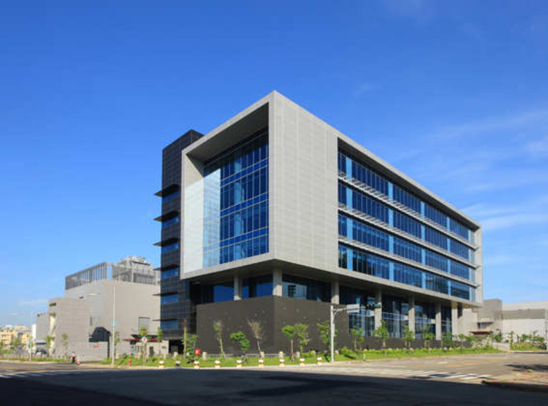



Business Services
Now & Outlook
- 2nd Largest Traded Sector - 4,750 jobs
- 10 Yr. Growth 69% - Avg. Wage $48K
Attributes - Low Capital
- Small - Diverse
- Global
Drivers - Entrepreneurs
- Innovation - Outsourcing - Demographics

Slide 8

IT Data Centers
Outlook
- $144 Billion Industry - HP, Microsoft
25% Annual Growth
Avg. Wage $81K
Attributes - High Capital
Energy Intensive - Technical Workforce
- Critical Infrastructure
Drivers - Software as a Service
- Cloud Computing - Outsourcing - Cyber Security - NOVA 32% US Market

Slide 9
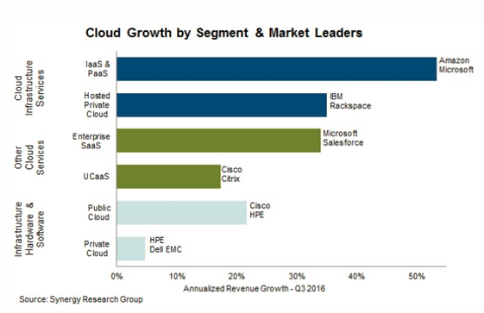
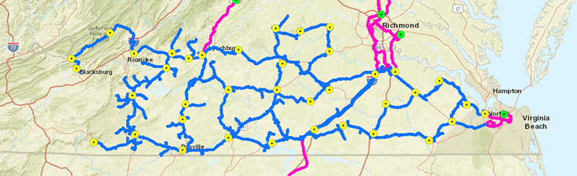
IT Data Centers – Growth, Regional Assets
Assets
- Mid-Atlantic Broadband - MAREA Cable
- DCC IT Academy - SVHEC / SVCC IT Certifications
- Energy

Slide 10





Advanced Manufacturing
Now & Outlook
- 1,530 jobs - $56 K Avg. Wage
- Core Growth
Existing & Aspirational
Clusters
Drivers - Assembly Plants
- Automation - Green Health - Transportation - For Profit Space Missions

Slide 11
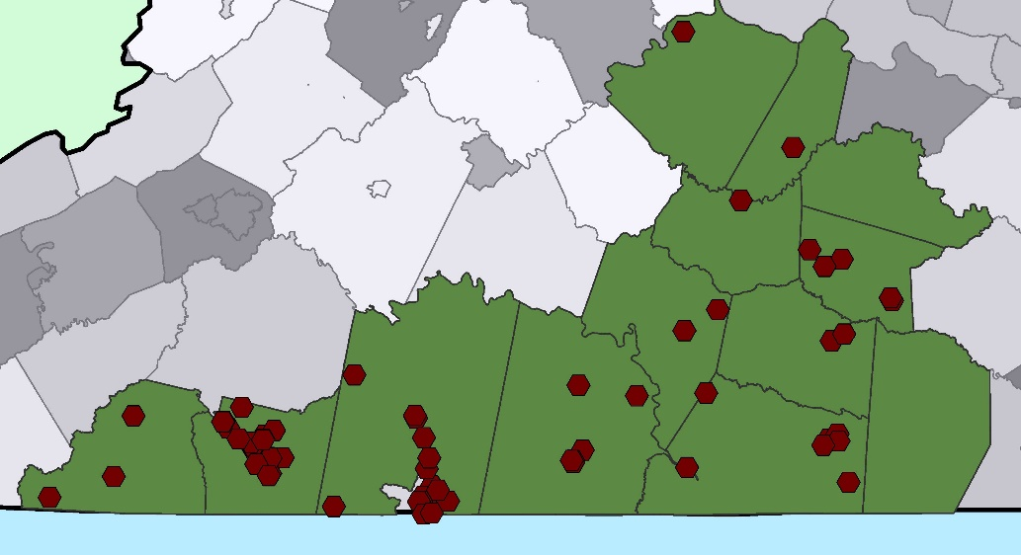
Advanced Manufacturing
Assets
- Haas Center - DCC Precision Machining
PHCC, NCI, SVHEC
Capacity
- Adjacent Market Access
Attributes - Machinists
- Additive Manufacturing - Small to Mid-Sized
- Global

Slide 12
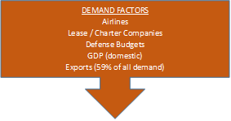



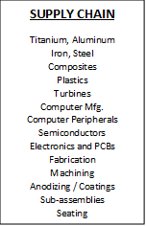
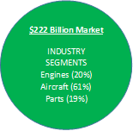

Aerospace Cluster at a Glance

Slide 13
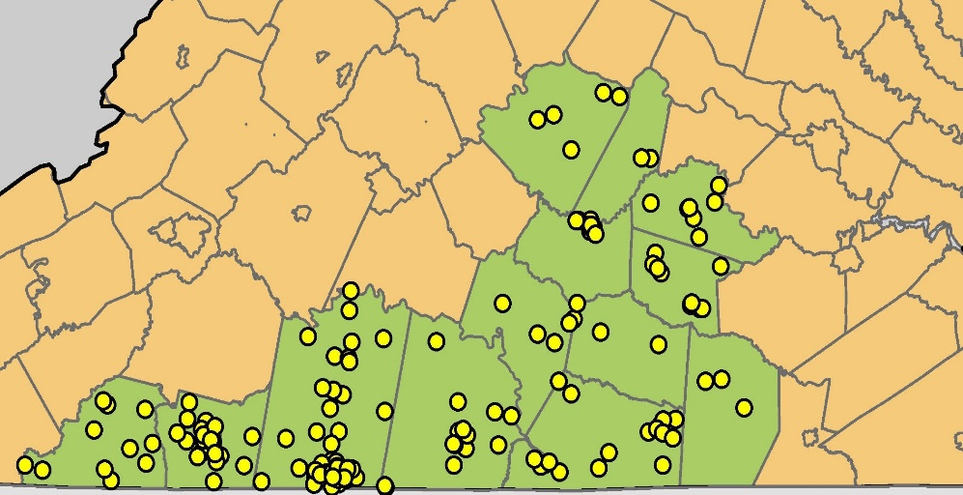
Advanced Materials
Now & Outlook
- Largest Traded Sector - 6,600 jobs - 70 companies, 48 HQ
- Steady Growth Fcst. - Avg. Wage $60K+
Attributes -Medium Capital
- Mid-sized to Large - Industrial B 2 B - Process Technology - Energy Intense
Drivers - Prefer semi-Rural
- Technicians vs. Operators - Natural Gas - World GDP - Port Access

Slide 14



High Value Wood Products
Now & Outlook
- 2nd Largest Traded Sector - 6,450 jobs - Forestry 15% Job Growth - Wood Products, 4% - Avg. Wage $51K+
Attributes -Low to Medium Capital
- Very small to mid-sized - 83% less than 50 Emp. - Green - Energy Intense
Drivers - Productivity
- Supply Chain - Entrepreneurial - World GDP - Port Access

Slide 15

High Value Wood Products – Pellet Fuel

Slide 16

Healthcare – A Vital Growth Sector
Now & Outlook
- 8.5% growth in last decade - 14,700 jobs - 3 of top 10 Occupations
- Steady Growth Fcst. - Avg. Wage $48K
Attributes -Medium to High Capital
- Consolidation - Funding flow in (Medicaid & Medicare) - Rural Physician Shortages
Drivers - Aging – 41.6 Years
- Poverty Rate of 19.6% - Workforce Participation of 54.6% versus VA @ 66.3%

Slide 17
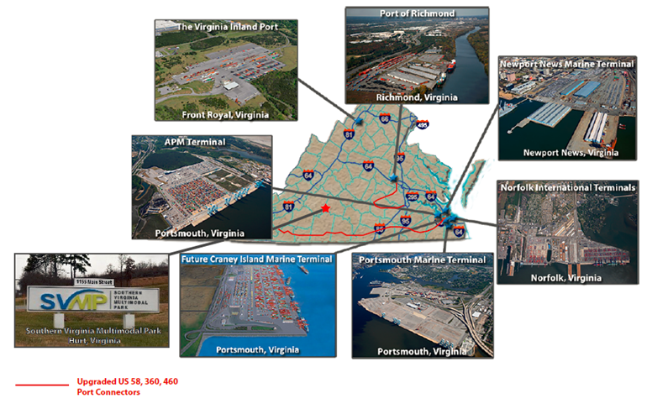
Infrastructure – Global Trade

Slide 18
Target Sectors for Traded Cluster Growth
Talent Development Pipeline Integration
Business Services and Data Centers
Unique, Attractive Regional Assets
Advanced Manufacturing & Materials
Talent Recruitment & Retention
Healthcare
Infrastructure (Technology, Logistics)
High Value Wood Products

Slide 19

About GENEDGE

Slide 20
Thank You. www.genedge.org Contact: Bill Donohue, bdonohue@genedge.org 276-732-5755 for further information.

