Slide 1



rdecker@impactmakers.org
Southern Virginia GO Region 3 Council Partners Update
Cyber Infrastructure Breakout Session
August 29, 2017

Slide 2
OUR MISSION
Impact Makers is driven to create meaningful change for our clients, our community partners, and ourselves. We will utilize our innovative business model to transform the business value of our work into social value for the community through partnerships with local non-profits that include financial contributions as well as pro-bono engagements.

Slide 3
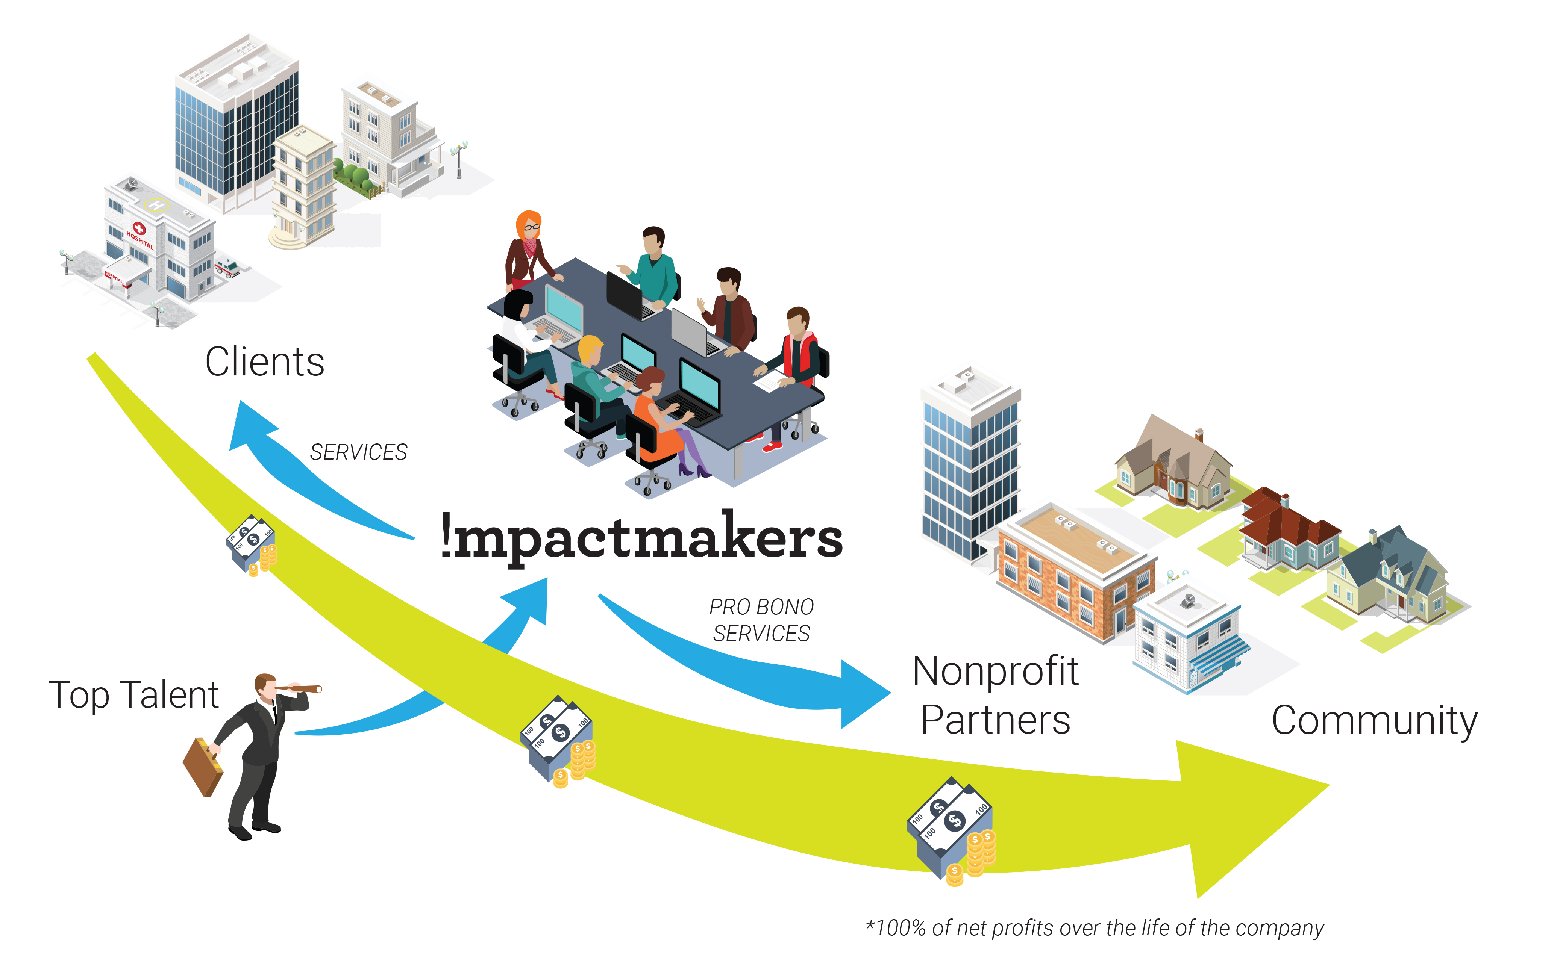
Community Impact
100% of net profits, over the life of the company, go to nonprofit partners
To date, that’s more than $2 million in cash & pro bono services
Impact Makers supports 8 community & pro bono partners and is owned by 2 foundations

Slide 4


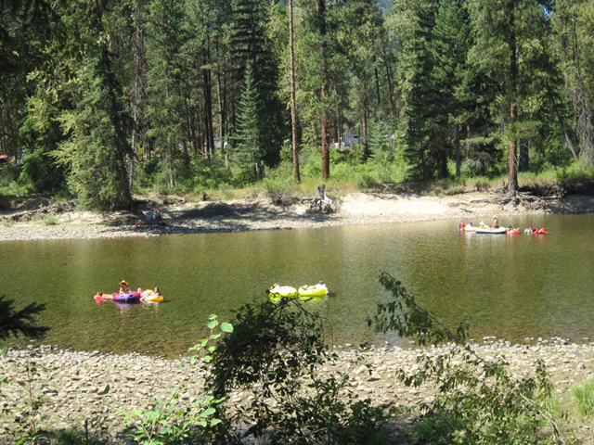
Methodology for Producing Cyber Infrastructure
Deep dive to understand how the area is changing to meet the work and lifestyle expectations of the desired younger workforce, what modern and innovative industries are in the area, and what potential is on the horizon

Slide 5
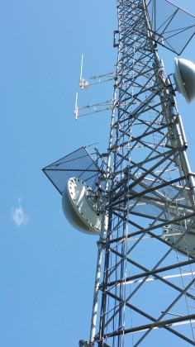
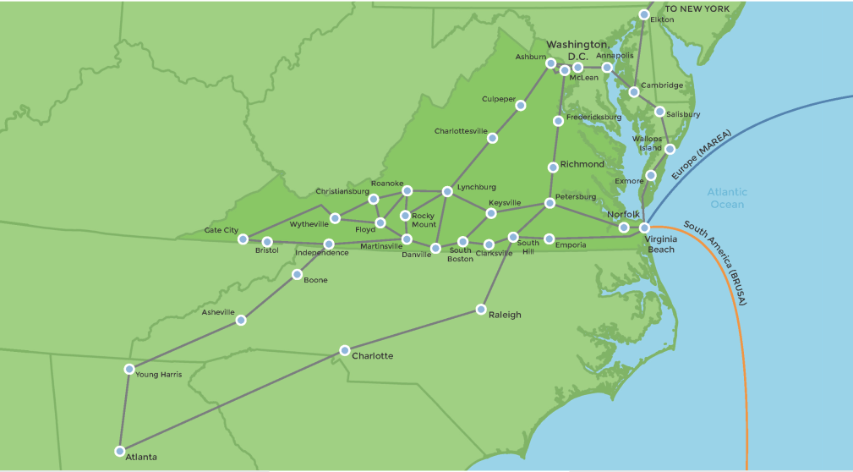
Methodology for Producing Cyber Infrastructure
Deep dive to understand broadband infrastructure capabilities, buildout methodologies, and the business model of Mid-Atlantic Broadband

Slide 6


Methodology for Producing Cyber Infrastructure
Deep dive to understand Region 3 “last mile” connectivity providers, installation efforts, and innovative solutions from other cities and localities

Slide 7

Methodology for Producing Cyber Infrastructure
General research into Internet of Things (IoT) and how it is already used in Region 3

Slide 8



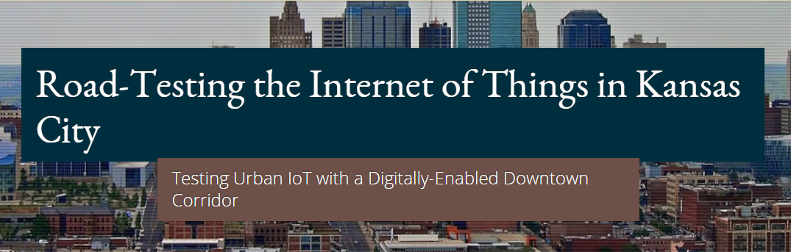
Methodology for Producing Cyber Infrastructure
Research into how other cities and localities are making use of their broadband capabilities and IoT to expand services, support government and business needs, and provide better and more economical services to citizens

Slide 9
Executive Summary
Through MBC, Region 3 has a fiber superhighway that has attracted several significant technology companies to the region and has positioned the region to capitalize on the future of IoT.
A Region 3 and MBC partnership can further improve broadband coverage by providing MBC region-wide tax-exempt status, fee waivers, and expedited easement access.
All localities in Region 3 need to pool resources and treat the broadband gap as a regional issue instead of individual locality issues.
A Region 3 can further enable ISP vendor’s ability to expand broadband coverage by providing tax breaks, tax incentives, fee waivers, and expedited easement access.

Slide 10
Next Steps
Commission the Broadband Expansion Focus Group. A focus group could be formed and defined within 2 months.
Define and document the concessions localities would be asked to offer expansion vendors.
Engage localities for acceptance, sign-off on, and implementation of concessions.
Review broadband expansion needs across the region.
Commission wireless broadband expansion study.
Engage MBC and ISP vendors to further define expansion plans and seek funding to pay for infrastructure.
Engage with regional ISP vendors to develop and implement incentives for providing broadband to low-income families across the region.
Commission the study to provide wireless broadband alternatives to families with school-aged children and adults returning to school.
Seek funding sources to offset infrastructure costs.
Evaluate IoT programs in known success regions: Bellevue, Washington, Kansas City, Missouri, Columbus, Ohio, and Chattanooga, Tennessee.

